Slide 1





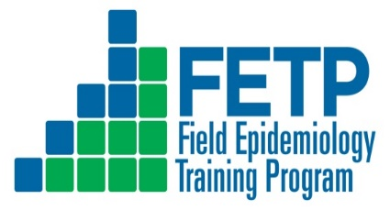

Characterization of Anthrax Cases in Kenya, 2014- 2023.
    Margaret Wanyeki Nganga¹ ⁵, Emmanuel Okunga¹, Daniel Langat¹, Samuel Kahariri², Mathew Mutiiria¹, Edward Tankoi³, Lawrence Gitonga⁴ , Maria Nunga⁵, Jack Omollo⁵, Caren Ndeta⁵, Athman Mwatondo⁵
¹ Division of Disease Surveillance and Response, Ministry of Health, Kenya
² State Department for Livestock Development, Kenya
³ Department of Health, Narok County, Kenya
⁴ Department of Health, Embu County, Kenya
⁵ Field Epidemiology and Laboratory Training Program, Ministry of Health, Kenya
One Health approach and climate-sensitive health threats
Kenya Health Security Convention | 5th – 8th May 2026 | Mombasa - Kenya

Slide 2
Background
Anthrax is a high-priority zoonotic disease in Kenya​
Affects humans, livestock, and wildlife​
Transmission occurs at the human-animal-environment interface​
Kenya experiences frequent outbreaks (>10 annually)​
Despite frequent outbreaks ; limited national-level data published​
Surveillance systems exist but are often analysed separately and have challenges​
Highlights the need for an integrated One Health surveillance for zoonoses ​
​

Slide 3
Objectives of the Study
Main Objective​
To characterize the epidemiology of anthrax in Kenya from 2014 to 2023 using integrated human and animal surveillance data within a One Health Framework​
Specific Objectives​
To describe the temporal and spatial distribution of anthrax cases in Kenya from 2014–2023​
To profile the epidemiological and clinical characteristics of anthrax in both humans and animals

Slide 4
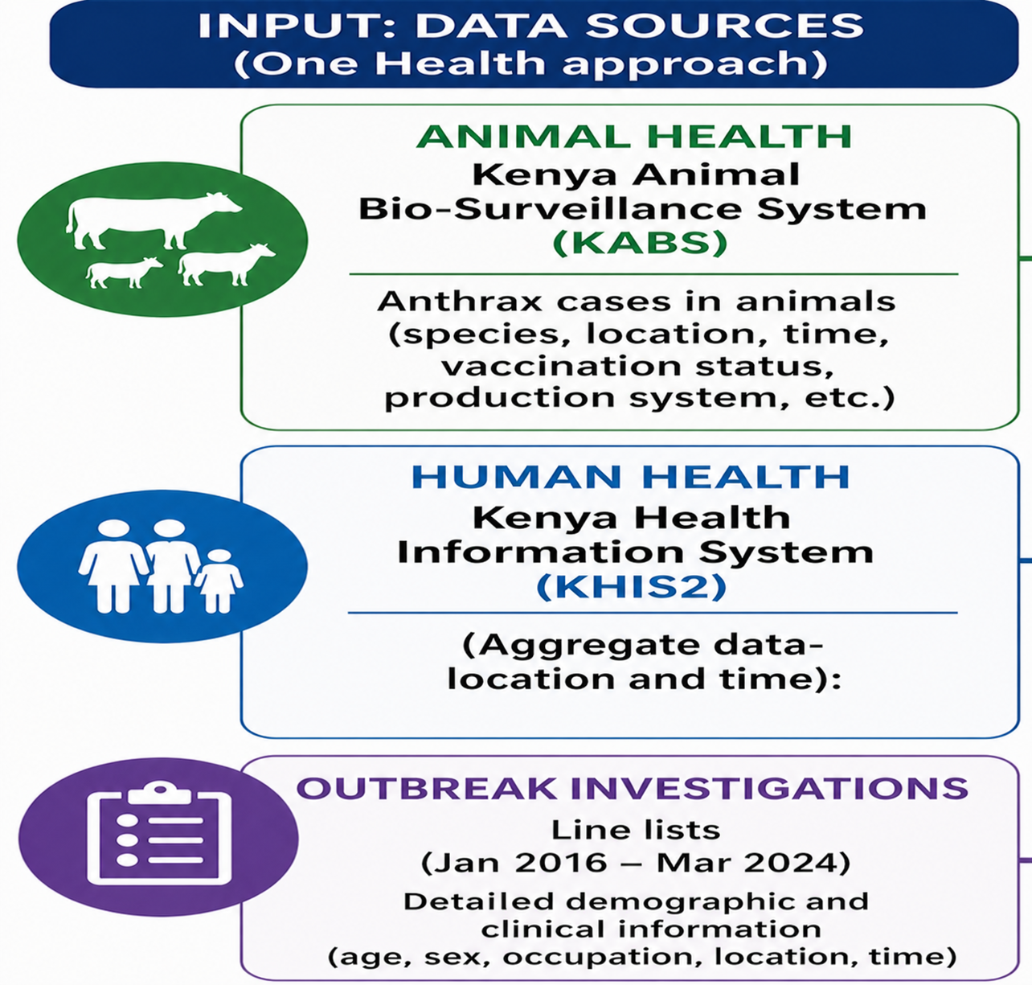
Methodology 1/2
  Study Design - Retrospective descriptive study using integrated surveillance data (One Health approach)
  Study Area & Period - Kenya from January 2016 – December 2023

Slide 5
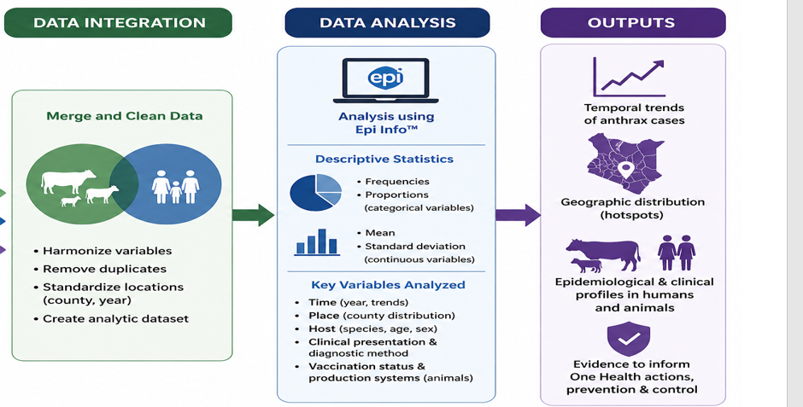
Methodology 2/2

Slide 6
Results: Findings from data abstraction
  A total of 674 were identified from the KABS system
  1168 from KHIS2
  672 records containing detailed demographic and clinical information were reviewed

Slide 7
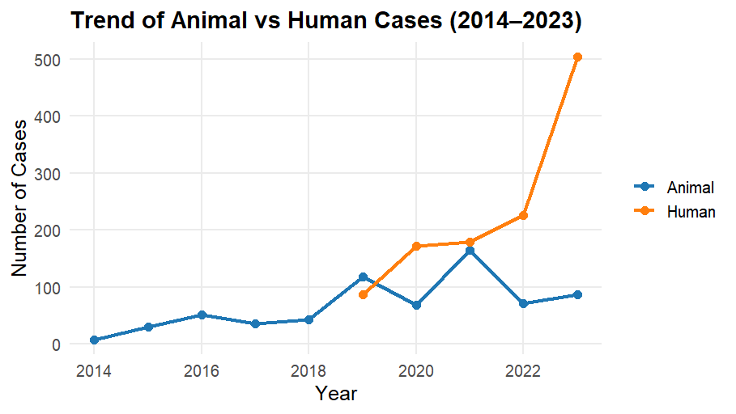
Results:Temporal and Spatial Trends ( KABs, KHIS2)
Notes:
Animal cases peaked in 2021, accounting for 24% (164/674) of all reported animal cases.
Human cases peaked later in 2023, contributing 43% (504/1,168)—suggesting a lag consistent with animal-to-human transmission patterns.

Slide 8
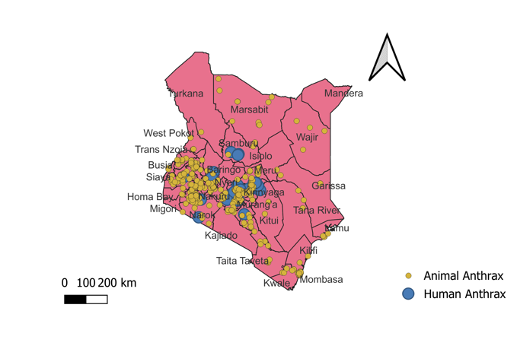
Results:Temporal and Spatial Trends ( KABs, KHIS2)
Distribution of Human and Animal Anthrax cases
Notes:
Highest animal cases was reported in Bomet County (12.8%).
Human cases were predominantly reported in Embu County (32%), indicating distinct but overlapping hotspot regions.

Slide 9
Results: Epidemiological Characterization ( Person analysis)
Distribution of Animal Anthrax cases by species, Kenya, 2016-2024 , n=672
Cattle most affected, accounting 89.7% (589/672)
Donkeys and rhinos were minimally affected, each about 0.15%.

Slide 10
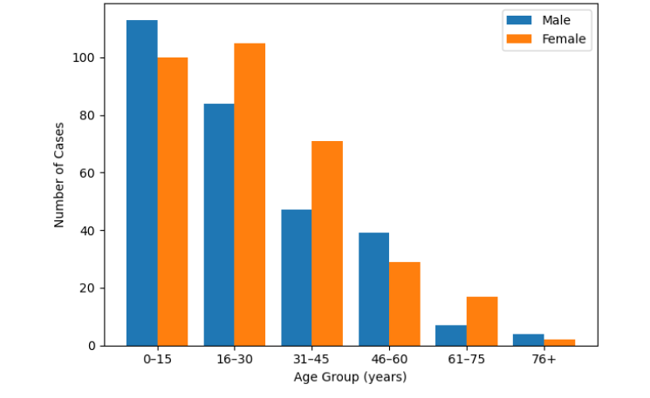
Results: Epidemiological Characterization ( Person analysis)
Gender distribution among affected age groups, Kenya , 2016 – March 2024 Outbreak, (n=618)
Mean age of cases: 27.8 years (±19.1)
Most affected Age-group- 0- 15 ; Female 47%, Male 53%

Slide 11
Results: Epidemiological Characterization of Anthrax-(Person)
Distribution of Human Anthrax cases by occupation, Kenya, 2016-2024 ,n=192
Farmers (30.7%) had the highest cases,
followed by students (21.4%) and housewives (12.5%), with meat dealers at 9.4%
indicating both direct occupational exposure
And significant household/community transmission.

Slide 12
Results:Clinical Profile Characterization -Diagnosis
Diagnosis Methods used ,reported Animal Anthrax Cases in Kenya, 2014- 2023, n=672
Diagnosis was largely clinical, accounting for 66% of animal cases and 99% of human cases,
Pointing to limited laboratory confirmation capacity.

Slide 13
Clinical Profile Characterization -Vaccination and Production systems
Production system:
  Majority cases reared in extensive production systems (418/618, 67.6%)
  Indicates higher exposure risk in these settings
Vaccination status:
  Among infected cattle(504), only 34% had been vaccinated, highlighting gaps in vaccination coverage

Slide 14
Discussion 1/2
Anthrax remains endemic with persistent hotspots, consistent with environmental spore persistence(WHO, 2018)
Spatial findings are broadly consistent with the anthrax hotspot map by Gachohi et al., confirming persistent endemic zones in Kenya
Observed increase in human anthrax cases reflects both improved detection and ongoing livestock-to-human transmission
Cattle are the main reservoir, with high susceptibility (exposure, low vaccination, extensive systems) sustaining transmission (Marston et al., 2011)
Human cases mainly affect economically active, occupationally exposed individuals at the human-animal-environment interface, consistent with One Health transmission pathways (Nzuki et al., 2017).

Slide 15
Discussion 1/2
Predominant clinical diagnosis limits laboratory confirmation and accurate burden estimation (CDC, 2023; WHO, 2018)
Strengthening One Health interventions; vaccination, integrated surveillance, and diagnostics is critical for effective anthrax control

Slide 16
Conclusion
Anthrax remains actively transmitted within Kenya’s anthrax belt due to gaps at the human- animal-environment interface
Strengthening diagnostics, and integrated One Health surveillance are essential for accurate detection and early response; effective control
Improved livestock vaccination and cross-sector coordination are key to reducing transmission
Priorities are to scale up livestock vaccination in extensive systems targeting cattle

Slide 17
Policy Impact and Implications
Anthrax continues to remain endemic in Kenya, indicating that elimination targets under the strategic plan are not yet fully on track.
Cattle, as high-value animals, are significantly affected, leading to notable economic losses for livestock-dependent communities.
Strengthening One Health coordination, livestock vaccination, and diagnostic capacity is essential for prevention and timely response

Slide 18






Thank you!
Scan to visit our website
#KeHSCon2026
@NPHIKenya
www.nphi.go.ke

